Slide 1
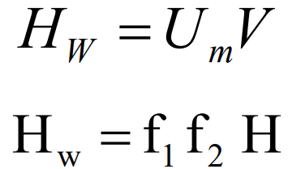
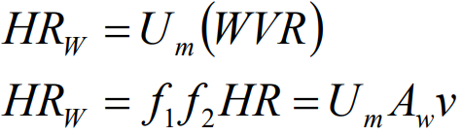
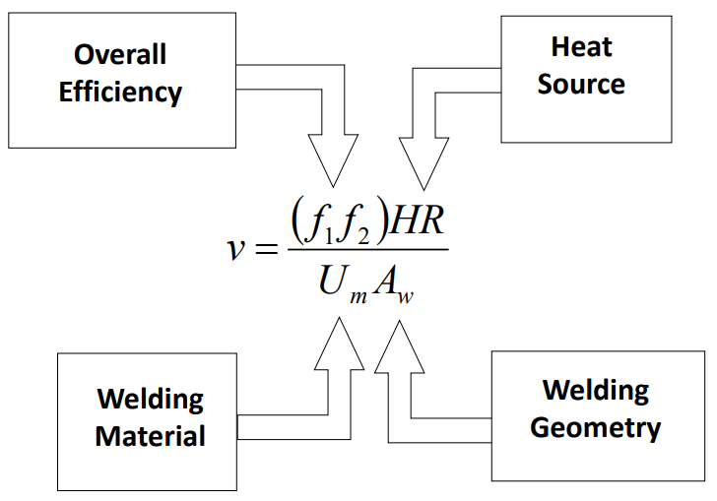
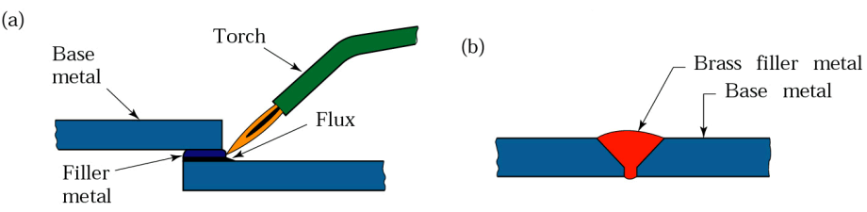
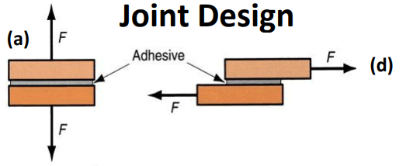
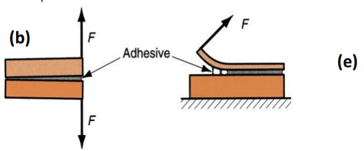
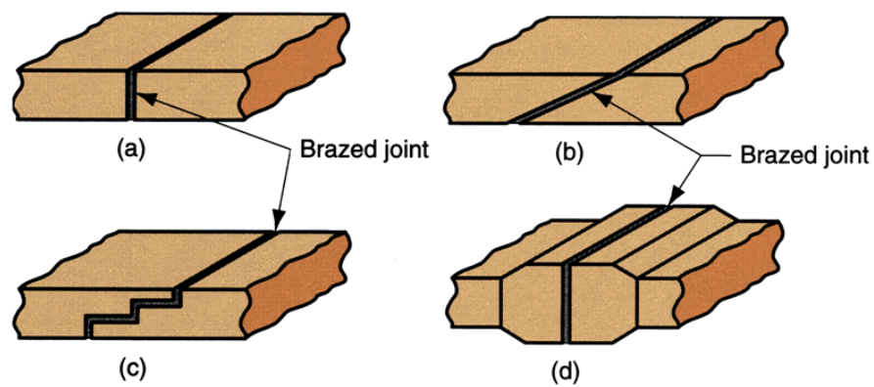
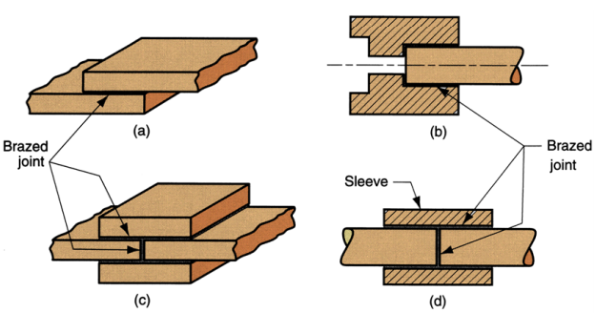
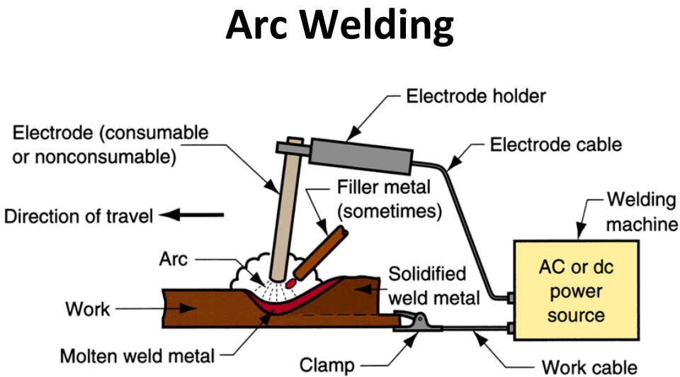
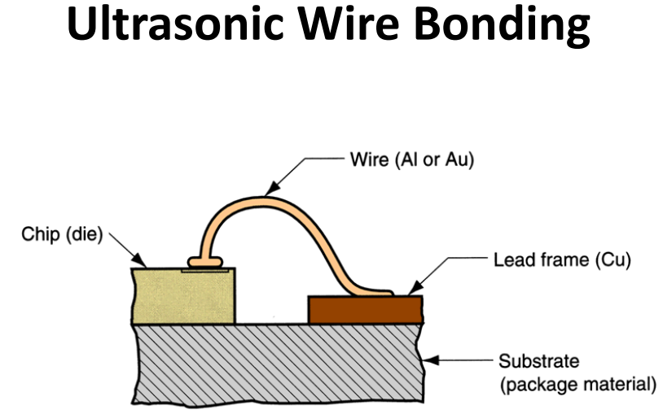
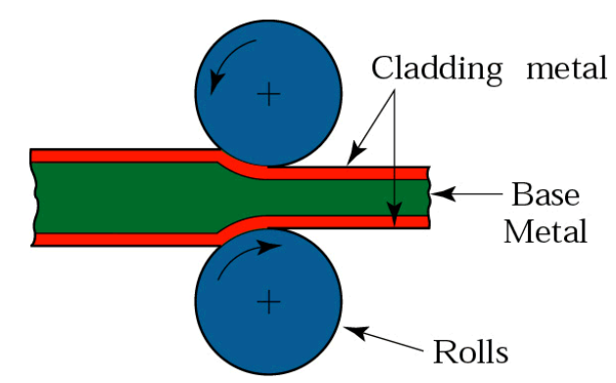
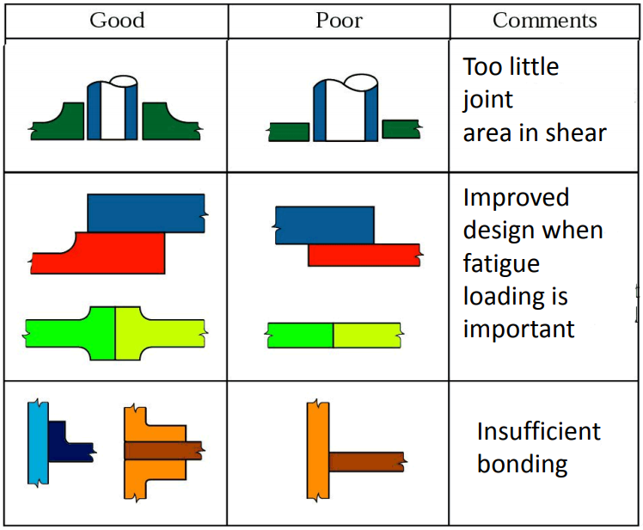
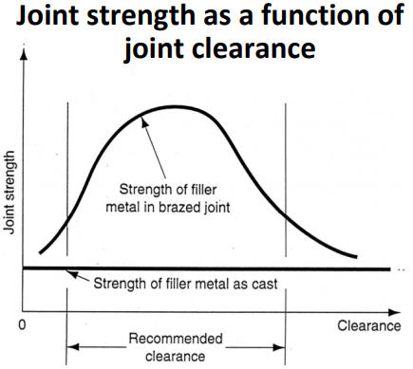
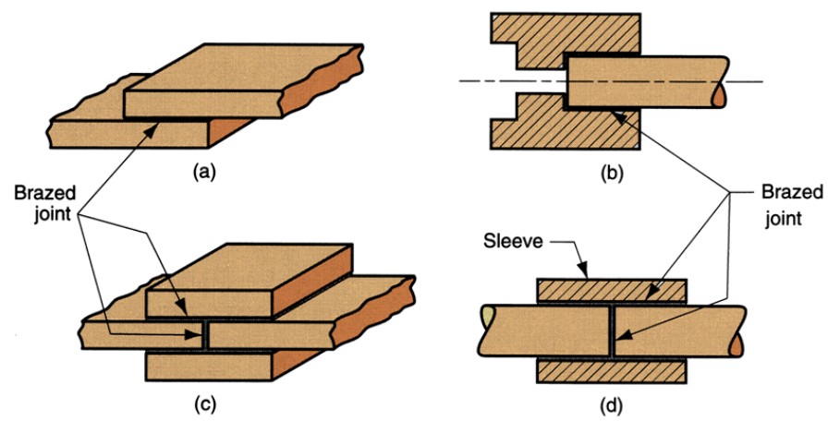
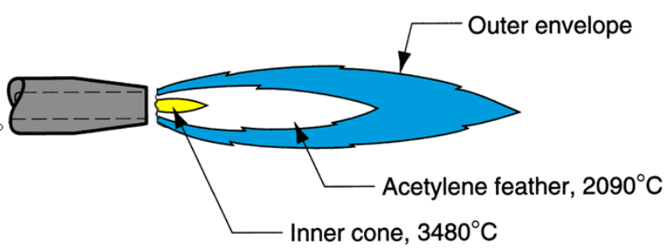
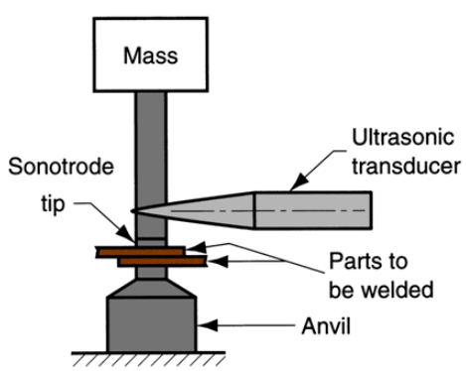
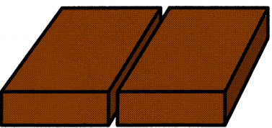
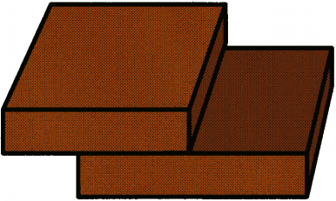
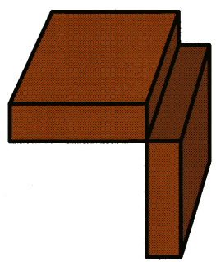
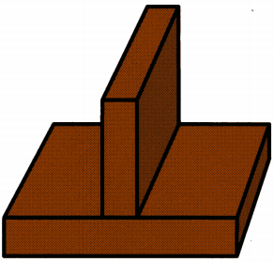
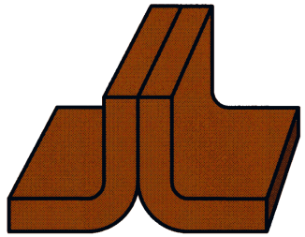
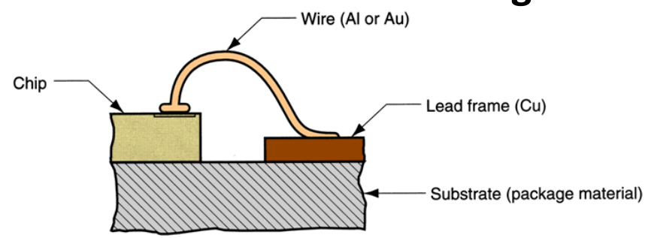
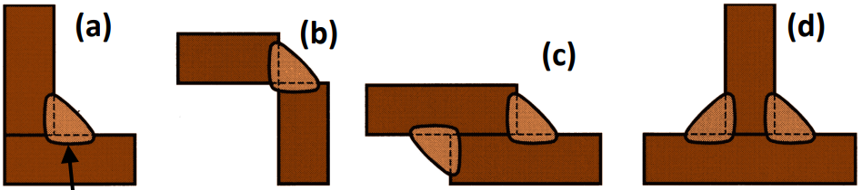
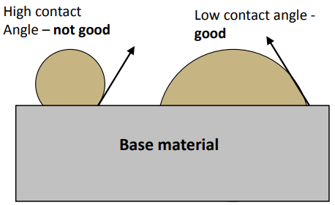
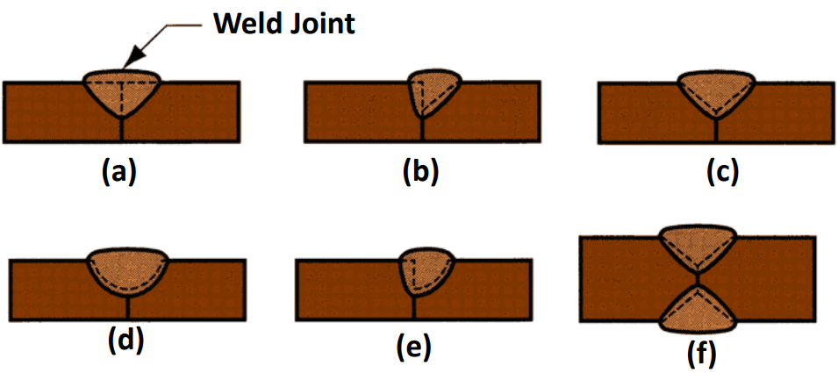
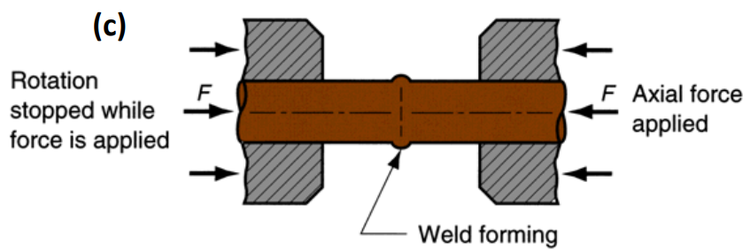
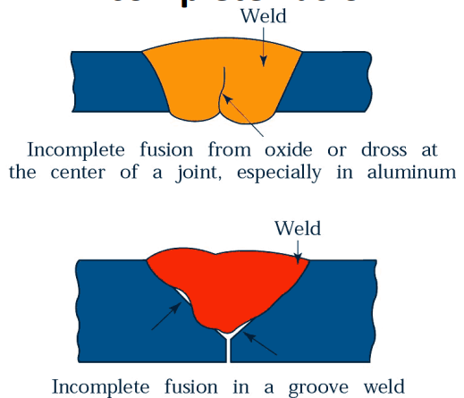
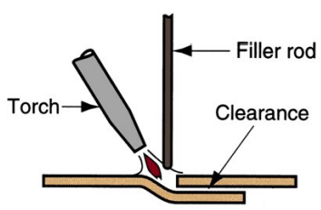
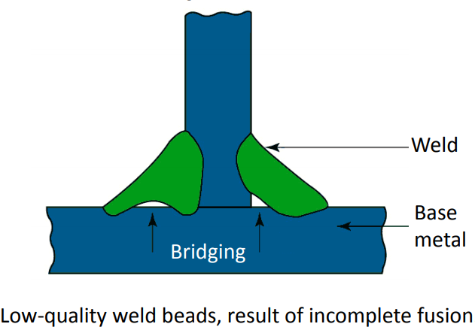
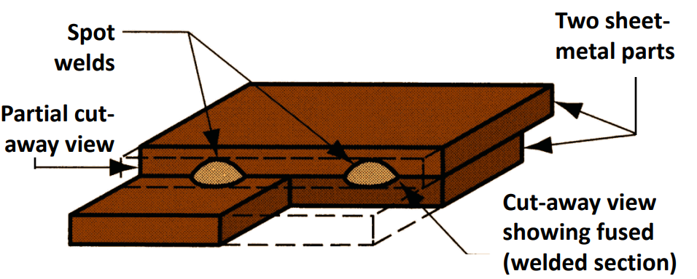
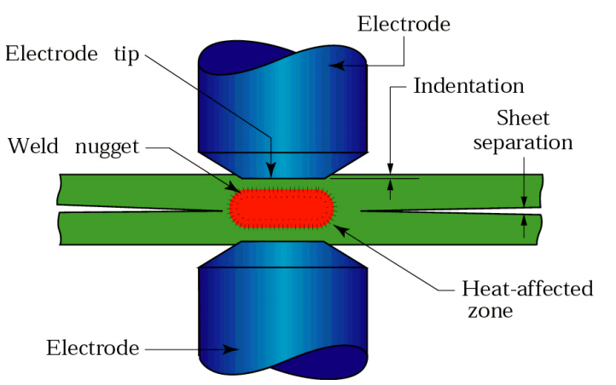
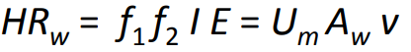
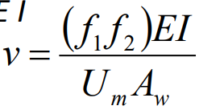
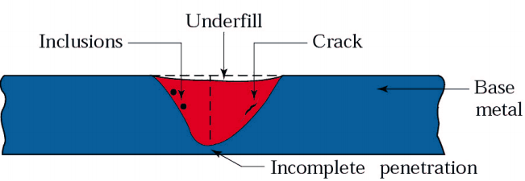
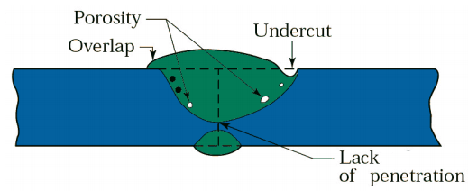
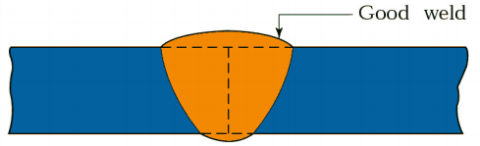
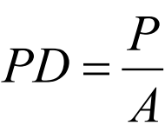
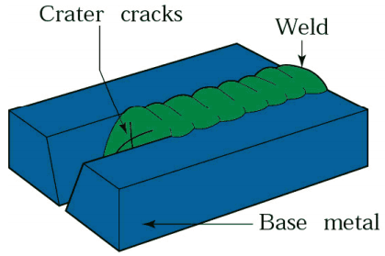
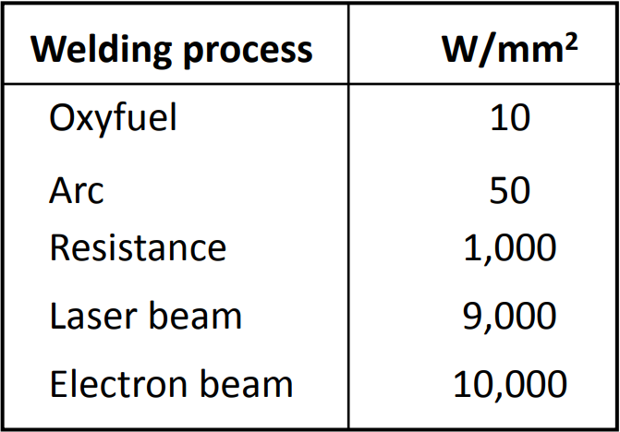
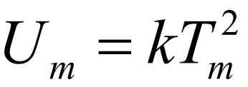
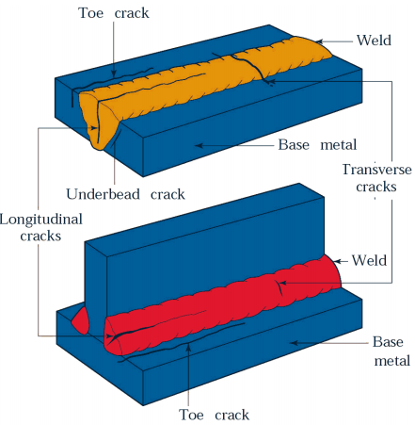
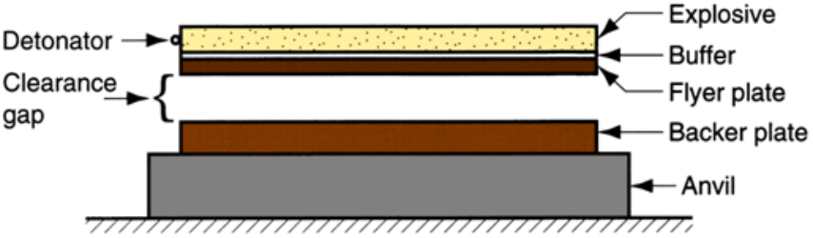
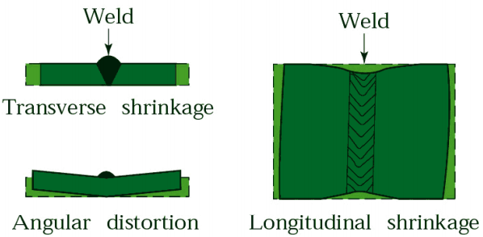
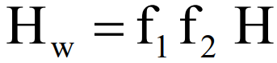
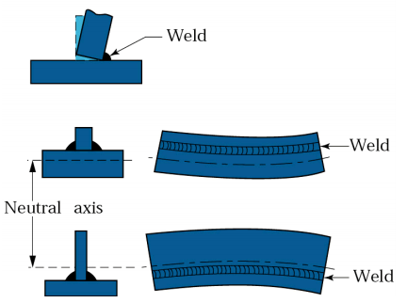
Joining – welding/brazing/soldering/adhesive bonding; processes form a permanent joint between parts Assembly – mechanical methods(usually) of fastening parts together; some allow for easy disassembly, while others do not Welding – >=2 parts coalesced at contacting surfaces by application of heat/pressure; can be either one or a combination of both; sometimes a filler material added to facilitate coalescence; essentially atomic bonding Fusion Welding – joining process that melt the base metals; filler metal added to molten pool to facilitate process & provide bulk & added strength to welded joint; e.g. arc welding(AW): melting metals by electric arc, Oxyfuel gas welding (OFW): melting by oxyfuel gas (acetylene, etc) autogenous weld: no filler metal used; Solid State Welding (SSW): Joining processes where coalescence results from application of pressure alone or combination of heat & pressure; if heat used, temp should be < melting pt of metals being welded; no filler metal is added in SSW, e.g. Friction Welding(FRW): coalescence by heat of friction between two surfaces, Ultrasonic welding (USW): coalescence by ultrasonic oscillating motion in a direction parallel to contacting surfaces of two parts held together under pressure, Resistance welding: melting is accomplished by heat from resistance to an electrical current between faying surfaces held together under pressure Types of Joints Fillet Welds (a) Inside single fillet corner joint; (b) Outside single fillet corner joint; (c) Double fillet lab joint; (d) Double fillet tee joint Groove Welds (a) square groove weld; one side; (b) single bevel groove weld; (c) single V-groove weld; (d) single U-groove weld; (e) single J-groove weld; (f) double V-groove weld for thicker sections. Spot Welds Small fused section between surfaces of 2 sheets/places - used for lap joints; Closely associated with resistant welding Physics of Welding fusion most common means of getting coalescence in welding; need source of high density heat energy must be supplied to faying surfaces -> resulting temp. cause localized melting of base metals/filler metals; melt metal with min. energy but high heat densities for metallurgical reasons Power Density (PD) Approx. PD for Welding Processes PD = power density, W/mm² P = power entering surface, W A = Surface Area over which energy is entering, mm² Unit Energy for Melting* Qty of heat required to melt a unit vol. of metal; sum of heat to raise temp. of solid metal to melting pt. (Depends on volumetric specific heat) + Heat to turn metal solid to liquid phase at melting pt. (Depends on heat of fusion); Um (j/mm³), T_{m} = melting pt of material, k = 3.33 × 10⁻⁶ for T_{m} in Kelvin (K) (K = ºC + 273) Two Heat Transfer Mechanisms - Not all of input energy used to melt weld metal; Heat transfer efficiency f₁ - actual heat received by workpiece divided by total heat generated at source; Melting efficiency f₂ - proportion of heat received at work surface used for melting; rest conducted into work metal Heat Available for Welding H_{w} = net heat available for welding; f₁ = heat transfer efficiency; f₂ = melting efficiency; H = total heat generated by welding process (Joules) Heat Transfer Efficiency f₁ - Proportion of heat received at work surface relative to total heat generated at source; Depends on welding process & capacity to convert power source (e.g. electrical energy) into usable heat at work surface: Oxyfuel gas welding - relatively inefficient; Arc welding - relatively efficient Melting Efficiency f₂ - Proportion of heat received at work surface used for melting, rest conducted into work metal; Depends on welding process, also influenced by thermal properties of metal, joint configuration, & work thickness; Metals with high thermal conductivity (e.g. Al, Cu) present a problem in welding because of rapid dissipation of heat away from heat contact area. | Energy Balance Equation H_{w} = net heat energy delivered to operation, J U_{m} = unit energy required to melt the metal, J/mm³ V = volume of metal melted, mm³ If time factor (rate) is considered: HR_{w} = rate of heat energy delivered WVR = Welding Volume Rate (mm³/min) A_{w} = weld area; v = welding speed Mechanical assembly – different from welding, No atomic bonding Oxyfuel Gas Welding (OFW) - Fusion welding operations that burn various fuels mixed with oxygen;OFW employs several types of gases, the primary distinction among the members of this group; Oxyfuel gas also used in flame cutting torches to cut and separate metal plates and other parts; Most important OFW process is oxyacetylene welding Torch Used in OAW The acetylene valve is opened first -> gas is lit with a spark lighter -> then O₂ valve opened and flame adjusted; Basic equipment used - For safety, all threads on acetylene fittings are lefthanded, those for O₂ are right-handed. Oxygen regulators are painted green, acetylene regulators red. Acetylene (C₂H₂) Most popular fuel -> capable of higher temp. (up to 3,480°C) chemical reaction of C2H2 and O2 - First stage reaction (inner cone of flame): C₂H₂ + O₂ ^{exothermic} 2CO + H₂; Second stage reaction (outer envelope): 2CO + H₂ + 1.5O₂ ^{exothermic} 2CO₂ + H₂O Acetylene (neutral flame) Max. temperature reached at tip of inner cone; Outer envelope spreads out & covers work surfaces to shield from surrounding atmosphere; f₁ = 0.1 - 0.3 Types of Flames Neutral Flame: The ratio of acetylene and oxygen is 1:1; Oxidizing flame: Greater oxygen supply. Harmful except for Cu and Cu-based alloys; Reducing (carburizing) flame: The ratio of oxygen is deficient. Temperature is low. Used for brazing, soldering, and flame hardening. Arc Welding (AW) - Fusion welding process where coalescence of metals achieved by heat from electric arc between an electrode & work; Electric energy from the arc produces temperatures ~ 5,500°C, hot enough to melt any metal; Most AW processes add filler metal to increase volume and strength of weld joint; Same basic process also used in arc cutting Electric Arc - Discharge of electric current across a gap in a circuit; Sustained by an ionized column of gas (plasma) through which current flows; To start the arc in AW, electrode is brought into contact with work and then quickly separated from it by a short distance. Air Welding - pool of molten metal formed near electrode tip -> As electrode is moved along joint, molten weld pool solidifies in its wake Power Source - DC / AC OR - Power HR = voltage × current = E I f₁, f₂: heat transfer and melting efficiency respectively; U_{m}: unit energy required to melt metal; A_{w}: weld cross-sectional area; v: travel velocity, HR_{w} : rate of heat generation Arc Shielding - At high temp. in AW, metals are chemically reactive to oxygen, nitrogen, and hydrogen in air; Mechanical properties of joint can be seriously degraded by these reactions; To protect operation, arc must be shielded from surrounding air in nearly all AW processes; Accomplished by: shielding gases (inert gas: Argon, helium, CO₂); flux; “joint not strong if any oxidation” Role of Flux - A substance that prevents formation of oxides and other contaminants in welding, or dissolves them and allows removal; Provides protective atmosphere for welding; Stabilizes arc; Reduces spattering Application Methods of Flux - Pouring granular flux onto welding operation; Stick electrode coated with flux material that melts during welding to cover operation; Tubular electrodes where flux is contained in core & released as electrode is consumed (filler metal can be added to increase volume/strength of weld joint) AW Electrodes – Consumable: consumed during welding process (Source of filler metal in arc welding); Nonconsumable: not consumed during welding process (Any filler metal must be added separately) Consumable Electrodes - Types: 1. Welding rods/sticks are ~30 cm long and ~8 mm in diameter & must be changed often, 2. Weld wire can be continuously fed from spools with long wires,avoid frequent interruptions; In both, electrode consumed by arc & added to weld joint as filler metal Nonconsumable Electrodes - Made of tungsten which resists melting; Gradually depleted during welding (vaporization is principal mechanism); Any filler metal must be supplied by a separate wire fed into weld pool | Shielded Metal Arc Welding (SMAW) - Uses consumable electrode -> filler metal rod coated with chemicals that provide flux & shielding; "stick welding” Gas Tungsten Arc Welding (GTAW) - Uses nonconsumable tungsten electrode & inert gas for arc shielding; Melting point of tungsten = 3,410°C; Also called TIG welding (Tungsten Inert Gas welding); Used with or without a filler metal; When used, filler metal is added to weld pool from separate rod or wire; Applications: aluminum and stainless steel most common. Other Fusion Welding Processes - FW processes that can’t be classified as arc/ resistance/oxyfuel welding; Use unique technologies to develop heat for melting; Applications typically unique; 1. Electron beam welding, 2. Laser beam welding Solid State Welding (SSW) - Coalescence of part surfaces achieved by: Pressure alone, or Heat and pressure; If both heat and pressure are used, heat by itself is not sufficient to cause melting of work surfaces; For some SSW processes, time is also a factor; Filler metal not added Success Factors in SSW - two faying surfaces must be very clean & In very close physical contact with each other to permit atomic bonding SSW Advantages over Fusion Welding Processes If no melting -> no heat affected zone ->metal around joint retains original properties; Many produce welded joints that bond entire contact interface between two parts rather than at distinct spots/seams; Some can be used to bond dissimilar metals, without concerns about relative melting points, thermal expansions, & other problems that arise in FW Solid State Welding Processes Forge/Ultrasonic/Friction/Resistance/Explosive/Diffusion welding Roll Bonding/Cladding Rolls thin out base metal with cladding metal outer surface Ultrasonic Welding (USW) - SSW process where two components are held together, & oscillatory shear stresses of ultrasonic frequency applied to interface cause coalescence; Oscillatory motion breaks down any surface films to allow intimate contact and strong metallurgical bonding between surfaces; Although heating of surfaces occurs, temperatures are well below T_{m}; No filler metals, fluxes, or shielding gases; Generally limited to lap joints on soft materials such as aluminum and copper. Friction Welding (FRW) - SSW process in which coalescence is achieved by frictional heat combined with pressure; When properly carried out, no melting occurs at faying surfaces; No filler metal, flux, or shielding gases normally used; Process yields a narrow HAZ; Can be used to join dissimilar metals; Widely used commercial process, amenable to automation and mass production; Size of weld zone depends on: Amount of heat generated, Thermal conductivity of materials, Mechanical properties of materials at elevated temperatures. Resistance Spot Welding (RSW) Sequence: Pressure applied -> current on -> current off, pressure on -> pressure released Key point: localized heat due to large electrical resistance; Most commonly used process in sheet-metal fabrication and in automotive-body assembly; Group of fusion welding processes that use a combination of heat and pressure to accomplish coalescence; Heat generated by electrical resistance to current flow at junction to be welded; Principal RW process = resistance spot welding (RSW). Components in Resistance Spot Welding Parts to be welded (usually sheet metal); 2 opposing electrodes; Means of applying pressure to squeeze parts between electrodes; Power supply from which controlled current can be applied for specified time duration. Heat source – resistance of circuit; Heat generated: H = I² R t; For resistance spot welding:Current I = 5,000 to 20,000 A;Voltage V < 10 v;Time t = 0.1 to 0.4 s Explosive Welding (EXW) Commonly used to bond two dissimilar metals, in particular to clad one metal on top of a base metal over large areas. Brazing & Soldering - Both use filler metals to permanently join metal parts; no melting of base metals; When is brazing/soldering preferred over fusion welding: metal has poor weldability; Dissimilar metals are to be joined; Intense heat of welding may damage components being joined; Geometry of joint do not lend itself to welding; High strength not required Adhesive Bonding - Uses forces of attachment between a filler material and two closely-spaced surfaces to bond parts; Filler material in adhesive bonding is not metallic; Joining process carried out at room temperature or slightly above. Strength of Brazed Joint - If joint properly designed & brazing operation properly performed, solidified joint will be stronger than filler metal Why? - Small part clearances used; Metallurgical bonding that occurs between base & filler metals; Geometric constrictions imposed on joint by base parts Limitations of Brazing - Joint strength < welded joint; High service temperatures may weaken a brazed joint; Color of brazing metal may not match color of base metal parts, a possible aesthetic disadvantage | Advantages Compared to Welding - Any metals can be joined, including dissimilar metals; Can be performed quickly and consistently, permitting high production rates; Multiple joints can be brazed simultaneously; In general, less heat and power required than FW; Problems with HAZ in base metal near joint are reduced; Joint areas that are inaccessible by many welding processes can be brazed, since capillary action draws molten filler metal into joint (a) Brazing and (b) braze welding processes Joints (a) Butt joint and adaptations for brazing; (b) scarf joint; (c) stepped butt joint; (d) increased X-section of part at joint. (a) Lap joint and adaptations for brazing (b) cylindrical parts; (c) sandwiched parts (d) use of sleeve to convert butt joint into lap joint. Brazing Design Desirable Brazing Metal Characteristics Low surface tension in liquid phase for good wettability; High fluidity for penetration into interface; Avoid chemical & physical interactions with base metal (e.g. galvanic reaction) Brazing Methods Torch/Furnace/Induction/Resistance/Dip/Infrared/Diffusion brazing Torch Brazing Technique for applying filler metal in brazing: torch and filler rod; before and after brazing operation. Brazing Fluxes - Similar purpose as in welding; they dissolve, combine with, and otherwise inhibit formation of oxides and other unwanted byproducts in brazing process; Characteristics of good flux: Low melting temperature; Low viscosity - can be displaced by filler metal; Facilitates wetting; Protects joint until solidification of filler metal Soldering - Joining process in which a filler metal with T_{m} <= 450°C is melted & distributed by capillary action between faying surfaces of metal parts being joined; No melting of base metals, but filler metal wets and combines with base metal to form metallurgical bond; Details of soldering similar to brazing, and many of same heating methods used; Filler metal called solder; Most closely associated with electrical and electronics assembly (wire soldering) Soldering Fluxes - Functions Be molten at soldering temps; Remove oxide films & tarnish from base part surfaces; Prevent oxidation during heating; Promote wetting of faying surfaces; Be readily displaced by molten solder during process; Leave residue that is non-corrosive and nonconductive Adhesive Bonding - Joining process in which a filler material is used to hold >=2 closely-spaced parts together by surface attachment; Used in a wide range of bonding & sealing applications for joining similar & dissimilar materials such as metals, plastics, ceramics, wood, paper, and cardboard; Considered a growth area because of opportunities for increased applications. Terminology in Adhesive Bonding - Adhesive = filler material, nonmetallic, usually a polymer; Adherends = parts being joined; Structural adhesives = of greatest interest in engineering, capable of forming strong, permanent joints between strong, rigid adherends. Curing in Adhesive Bonding - Process where physical properties of adhesive change from liquid to solid, usually by chemical reaction, to accomplish surface attachment of parts; Curing often motivated by heat and/or a catalyst; If heat is used, temps relatively low; Curing takes time - a disadvantage in manufacturing; Pressure sometimes applied between parts to activate bonding process. Joint Strength - Depends on strength of: Adhesive, Attachment between adhesive & adherends; Strength of attachment involves: Chemical bonding – adhesive and adherend form a primary chemical bond upon curing Physical interactions - secondary bonding forces between atoms of opposing surfaces, Mechanical interlocking - roughness of adherend causes hardened adhesive to become entangled or trapped in its microscopic surface asperities | Joint Design Adhesive joints are not as strong as welded/brazed/soldered joints; Joint contact area should be maximized; Adhesive joints are strongest in shear, compression & tension -> Joints should be designed so applied stresses are of these types; Adhesive bonded joints are weakest in cleavage or peeling -> Joints should be designed to avoid these types of stresses (a) Tension (b) Shear (c) Cleavage (d) Peeling Poor Joint Design - have small contact areas between members to be joined Good Joint Design - have large contact areas between members to be joined Applications of Adhesives - Automotive, aircraft, building products, shipbuilding; Packaging industries; Footwear; Furniture; Bookbinding; Electrical & electronics Surface Preparation - For adhesive bonding to succeed, part surfaces must be extremely clean; Bond strength depends on degree of adhesion between adhesive and adherend ->depends on cleanliness of surface; For metals, solvent wiping often used for cleaning, & abrading surface by sandblasting improves adhesion; For nonmetallic, some solvent cleaning generally used, & surfaces are sometimes mechanically abraded or chemically etched to increase roughness. Advantages - Applicable to wide variety of materials; Bonding occurs over entire surface area of joint; Low temperature curing avoids damage to parts being joined; Sealing as well as bonding; Joint design -often simplified, e.g., two flat surfaces can be joined without providing special part features (e.g. screw holes) Limitations - Joints not as strong as other joining methods; Adhesive must be compatible with materials being joined; Service temperatures limited; Cleanliness and surface preparation prior to application of adhesive important; Curing times can impose a limit on production rates; Inspection of bonded joint is difficult Features of Fusion Welded Joint - Typical fusion weld joint in which filler metal has been added consists of: Fusion zone; Weld interface; Heat affected zone (HAZ); Unaffected base metal zone Heat Affected Zone - Metal has experienced temperatures below melting point, but high enough to cause micro structural changes in solid metal; Chemical composition same as base metal, but this region has been heat treated so that its properties & microstructures have been altered; Effect on mechanical properties in HAZ is usually negative; it is here that welding failures often occur. Defects in Welded Joints – Discontinuities: Porosity, Slag inclusions, Incomplete Fusion & Penetration; Incomplete Fusion Poor Weld Profile – underfill; undercut; excessive overlap Cracks - Cracks caused by thermal stresses developed during solidification and contraction of weld bead and surrounding structure; Cracks in butt and T joints Causes of Crack in a Weld Bead - Thermal stresses due to temperature gradients; Variation in composition; Embrittlement of grain boundaries (segregation); Hydrogen embrittlement; Inability to contract (causing tensile stresses) Solutions to Crack Problem - Change joint design to minimize stresses from shrinkage during cooling; Change the parameters, the procedures, & sequence Detection of Cracks - Ultra-sonic detection; Radiation detection (x-rays or gammarays). Distortion after Welding - Butt joints: Distortion caused by differential thermal expansion & contraction of different parts of welded assembly Fillet welds: Distortion caused by differential thermal expansion and contraction of different parts of the welded assembly.
Too little joint area in shear
Improved design when fatigue loading is important
Butt | Lap | Corner | Tee | Edge
Insufficient
bonding
AW Processes that use Consumable Electrodes | AW Processes that use Nonconsumable Electrodes
Shielded Metal Arc Welding Gas Metal Arc Welding Flux-Cored Arc Welding Submerged Arc Welding | Gas Tungsten Arc Welding Plasma Arc Welding Carbon Arc Welding Stud Welding

Slide 2
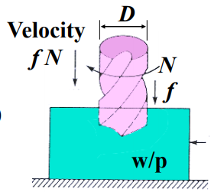
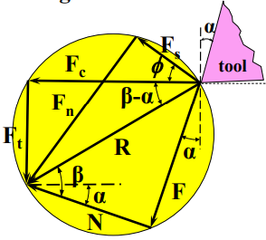
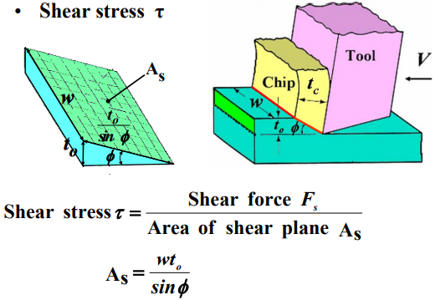
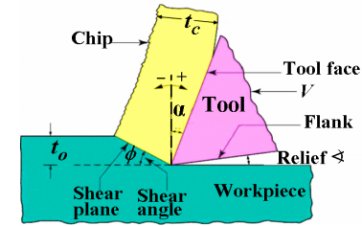
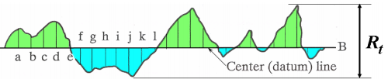




























Machining - Removal of material from a workpiece to give the required shape, dimensions and surface finish; Cutting: turning, milling, drilling, sawing; Abrasive: grinding, polishing, lapping; Advanced machining: electrical-discharge, electron beam, laser beam, water-jet, chemical Examples of cutting – straight turning; cutting off; slab milling; end milling; face milling; drilling; parts produced by chemical milling - Missile skin-panel section contoured by chem. milling to improve stiffness-to-weight ratio of part; weight reduction of space launch vehicles by chem. milling aluminumalloy plates. Why machining? - Good dimensional accuracy; Good surface finish; Different shapes & special features can be machined: accurate round holes, very straight edges & surfaces; Cheaper to produce parts by machining Disadvantages - Waste materials (chips); Generally takes longer time to shape given part; Can have adverse effects on surface quality & properties of product Machining operation – view as a system; System consists of machine tool, workpiece (w/p), cutting tool & machinist Fundamentals of Machining - Mechanics of chip formation; Force and power requirements; Temperature rise in cutting; Tool wear and Tool life; Types of chips; Surface finish of machined parts Cutting models: Orthogonal & Oblique Orthogonal cutting model - cutting tool moves along the w/p with cutting velocity V & depth t_{o} (undeformed chip thickness). Chip is formed due to plastic deformation and shearing of the material along the shear plane. Chip thickness formed is t_{c} Mechanics of chip formation Positive & Negative Tool rake angle Cutting ratio r - r = t₀/t_{c}; t_{c} > t₀ (r < 1) t₀ = l_{s}sinφ; t_{c} = l_{s}sin∠ABC r = t₀/t_{c} = sinφ/cos (φ - α) Shear angle φ - r cos (φ - α) = sin φ; r (cosφcosα + sinφsinα ) = sin φ Divide by cos φ: r (cos α + tan φ sin α) = tan φ tan φ (1 – r sin α) = r cos α tan φ = r cos α/1 - r sin α General shear strain γ formula Thin rectangular element of thickness d and shear stresses τ applied in opposite directions to cause deflection Shear Strain γ = AB / d (where AB is the distance deflected) Chip formation base on card model - Chip produced by shearing. Chip formation like a deck of cards (elements) sliding against each other; Thickness of shear element d is very small – about 10⁻² to 10⁻³ mm Merchant’s Equation - assumed that φ adjusts itself to give min cutting force F_{c} Cutting forces – importance: 1. Establish power for selection of machine tool; 2. Machine tool can be properly designed; minimize distortion of machine components; maintain dimensional accuracy of machined part; appropriate tool holder & work holding device selected; 3. W/p must withstand cutting forces Cutting forces acting on turning tool - If F_{t} is too high or m/c tool not sufficiently rigid, tool will be pushed away from w/p surface – reduce depth of cut, lost of dimensional Accuracy; Tool holder, work holding device, & m/c tool must be rigid to minimize deflections caused by F_{t} | Forces on shear plane - R is balanced by an equal & opposite force along shear plane & is resolved into: Shear force F_{s}; Normal force to shear force F_{n}; Resultant force R is of same magnitude & colinear for all three cases Forces and force circle diagram Cutting force F_{c} & thrust force F_{t} can be measured. Other forces can be derived: F_{s}, F_{n}, F, N β = friction angle; F = R sin β; N = R cos β; µ = F/N = tan β; µ ≈ 0.5 to 2 Power = Force x Velocity Power (cutting) = F_{c}V This power is dissipated in two main areas: Shear plane - to shear the material; Tool-chip interface – to overcome friction Power (shearing) = F_{s}V_{s}; Power (friction) = FV_{c}; F_{c}V = F_{s} Vs + FV_{c} Material Removal Rate (MRR) (volume of material removed per sec) = Area of cross-section of cut x Velocity perpendicular to area; MRR 71 = wt_{o}V mm³/sec Temperature in cutting - Energy dissipated in cutting is converted into heat, which raises temp. in the cutting zone;2 main sources of heat generation: 1. Shear zone (shear plane) - shearing 2. Tool-chip interface - friction As V ↑, time for heat dissipation ↓ & temp. ↑ Typical temperature (ºC) distribution in cutting Zone - Severe temperature gradients within tool & chip; Max temp. is about halfway up tool-chip interface Percentage of heat generated in cutting Chip carries away most of the heat; As V ↑, higher % of heat is carried away by the chip Tool wear & Tool Life - Cutting tool subject to: a) High localized stresses b) High temperatures c) Sliding of chip along rake face d) Sliding of tool along freshly cut surface → tool wear→tool life, quality of machined surface, dimensional accuracy&cost Tool wear regions – wear on cutting model/turning tool; 2 principals of tool wear crater & flank wear; others: nose radius & notch wear Flank wear – occurs in flank face; causes: 1. rubbing of tool along machined surface, 2. high temperatures affecting properties of tool material Crater wear - occurs on rake face of tool (tool-chip interface); causes: 1. Temp. at tool – chip interface, 2. Chemical affinity between tool & w/p material – diffusion mechanism (Using coated cutting tools e.g. cutting tools coated with TiC & TiN, slow down diffusion, thereby reducing cater wear) When to re-sharpen or replace cutting tool? – 1. Tool wear (e.g. you can set the maximum flank wear land width VB as 0.4 mm), 2. Workpiece surface finish becomes worse, 3. Cutting forces ↑ significantly, 4. Temperature ↑ significantly Taylor’s tool life equation - VT^{n} = C; V = cutting speed (m/min); T = tool life (min); n = exponent (<1); C = constant; Note: Each combination of w/p and tool material, and cutting condition has its own n and C values Tool life curve - VT^{n} = C; log V + n log T = log C; log V = -n log T + log C; n is slope (gradient) & C is intercept Extended Taylor’s tool life equation: V T^{n} d^{x} f^{y} = C V = most significant variable; d = depth of cut (mm); f = feed (mm/rev); x & y determined experimentally | Chips - Chips have significant influence on: 1. Surface finish of workpiece 2. Cutting operations (e.g. tool life, vibration, chattering); 4 types of chips: Continuous, Discontinuous, Built-up edge, serrated & segmented Continuous chips - 1. Usually formed with ductile materials at high cutting speed; 2. Generally gives good surface finish; 3. Tend to entangle around toolholder, work holding device & w/p – operation has to stop to clear chips Remedy for continuous chips - 1. Change machining parameters e.g cutting speed, feed 2. Use chip breaker to decrease radius of chip, chip bents & breaks Discontinuous chips - Normally occur under following conditions: 1. brittle materials – they cannot withstand high shear strains; 2. materials containing hard inclusions/impurities; Cutting forces vary during cutting Built-up edge (BUE) – 1. A BUE consists of layers of w/p material deposited gradually on tool. BUE ↑, becomes unstable & breaks up eventually; 2. Part of BUE material is carried away by chip & rest deposited randomly on w/p surface, giving poorer surface finish (rougher); 3. BUE changes geometry of cutting edge and makes it dull e.g. tool tip profile. This gives poorer surface finish (surface becomes rougher). Serrated (segmented chips) - Semi-continuous chips with large zone of low shear strain & small zone of high shear strain (saw tooth like appearance); Found in metals with low thermal conductivity & strength that decreases sharply with temperature e.g. titanium Surface finish - Surface roughness Parameters; R_{a} = (a + b + c …)/No. of readings R_{t} = distance between highest peak and lowest valley Factors affecting surface finish – 1. BUE (Built-up edge) [affects tool-tip profile (greatest influence on surface finish); Ceramic & diamond tools have lower tendency to form BUE - gives better surface finish than other tool materials]; 2. Feed marks left by cutting operations 3. Vibration - If a tool vibrates during cutting, it will give poor surface finish; 2 basic type of vibration in machining: (a) forced vibration (b) self-excited vibration (commonly called chattering). Cause of forced vibration - periodic applied force present in the machine tool, such as from gear drives, motor and pumps. Cause of chattering (self-excited vibration) - interaction of the cutting process & the structure of the machine tool. Typically begins with a disturbance in the cutting zone: for example, types of chips produced, variations in frictional conditions at tool-chip interface; Excessive chattering – cause chipping & premature failure of brittle cutting tools (e.g. ceramics & diamond). Cutting Tool – Rake ∠; Throw-away inserts: one insert has several cutting edges; Carbide throw-away inserts (e.g. WC, TiC) of diff shapes for turning process; the smaller the included angle, the more likely to chip/break (circle strongest) Cutting model & tool rake angle - Positive rake angle (+ve α): (1) Lower cutting force; (2) Lower temperature rise (3) Weaker cutting edge - this may cause chipping & failure; Negative rake angle (-ve α): (1) Stronger cutting edge; (2) Both sides of tool inserts can be used; E.g. for a △ insert - +ve rake has 3 cutting edges; -ve rake has 6 cutting edges One piece solid cutting tool (cutter) - e.g. high speed steels (HSS) tool; slab milling cutter; twist drill; Interrupted cutting Milling - example of interrupted cutting; Teeth of milling cutter enter and exit the w/p during each revolution; Interrupted cutting action subjects the teeth to a cycle of impact forces and thermal shock on every rotation Cutting tool materials – Diamond, Carbon & medium alloy steels; Highspeed steels (HSS); Castcobalt alloys; Carbides – WC, TiC; Carbides - Coated tools; Ceramics; Cubicboron nitride Characteristics of a good cutting-tool material – Hot hardness; toughness; thermal shock resistance; wear resistance; Chemical stability & inertness Hot hardness - Hardness of tool at cutting temps. must be maintained; Tool do not undergo plastic deformation so that shape & sharpness of tool retained Toughness & impact strength (mechanical shock) - to prevent chipping or fracturing of tool due to: 1. impact forces (especially for interrupted cutting operations) 2. vibration & chattering during machining Thermal shock resistance - Twithstand rapid temperature cycle encountered in interrupted cutting Wear resistance - High wear resistance especially at cutting temperatures; Acceptable tool life – before tool has to be replaced Chemical stability & inertness - avoid adverse reactions with w/p causing tool wear e.g. carbon diffusion Cutting Tool – Materials Selection - High speed steel (HSS): High toughness – high resistance to fracture; suitable for: 1. Tool with high +ve rake angle (small included angle); 2. Interrupted cuts; 3. Machine tools with low stiffness (that causes vibration & chattering); Limitation: Lower cutting speed than WC due to lower hot hardness Uncoated tungsten carbides: WC without coating; WC – a composite of tungsten carbide particles bonded together in a cobalt matrix; High hot hardness, toughness & wear resistance | Uncoated tungsten carbides (WC): Generally for cutting steels, cast irons & abrasive non-ferrous materials; As cobalt ↑, toughness ↑ but other properties (strength , hardness, wear resistance) ↓ Uncoated titanium carbides (TiC): Higher wear resistance than WC but not as tough; Suitable for machining hard materials & for cutting speeds higher than that for WC; Coated tools (e.g. WC carbides coated with TiN , TiC, Al2O3 coatings): Compared to uncoated carbides->Higher resistance to crack & wear; Lower friction; Higher hot hardness; Prevents diffusion; Longer tool life Multi-phase coatings: Substrate -> HSS, carbides; Coating materials -> TiN, TiC, ceramics, diamond; Thickness of coating: 2 – 15 µm Ceramics (e.g. Al2O3): High hot hardness & wear resistance; Less tendency to adhere to metals during cutting, therefore lower tendency to form BUE – gives good surface finish; Suitable for uninterrupted cutting operations (e.g. turning) – for high speed finishing; Limitations: 1. Low toughness & impact strength – may cause premature failure by chipping or tool fails without warning (catastrophic failure); 2. -ve rake angle (large included angle) preferred; 3. Low thermal shock – to reduce cracking due to thermal shock, cutting should be performed dry (no cutting fluid used) or with limited cutting fluid applied in steady quantity Cubic boron nitride (CBN): CBN is next hardest material after diamond; Has high wear resistance & high cutting-edge strength; At elevated temp, CBN is chemically inert to iron and nickel; Has high oxidation resistance -> CBN is suitable for cutting hardened ferrous and high temperature alloys (eg nickel-based alloys); Limitations: Brittle & low thermal shock Diamond: High hardness & wear resistance; Low friction; Can maintain a sharp cutting edge; Used when good surface finish & dimensional accuracy are required; Limitations: Brittle; Low chemical stability at higher temps (transform to carbon); Most suitable for light, uninterrupted finishing cuts; Not for machining plain-carbon steels, nickel, titanium, because of strong chemical affinity at elevated temperatures. Cutting Fluid - May be lubricant/coolant or both; Lubricant – reduces friction (tool-chip & tool-workpiece); Coolant – reduces effects of heat in machining; Types of cutting fluid: Oils, emulsions, synthetic & semi-synthetic solutions Why use? - 1. Reduce friction & wear – tool life ↑, better surface finish; 2. Cool the cutting zone – temp. & thermal distortion ↓, tool life ↑ . Water removes heat effectively but causes rusting; 3. Reduce forces & power consumption; 4. Wash away chips; 5. Protect machined surfaces from corrosion Potential Problems – may not be able to recycle & Corrosion Turning – round parts produced by turning the w/p on a lathe. A single point cutting tool is used; Various cutting operations on lathe Comparing turning & cutting model – f = t_{o}, d = w, V is the same Cutting Speed V & rotational speed N - As w/p rotates one revolution, a point on the w/p diameter D will move a distance of πD m; In N rev, the point will move πDN m; In N rev/min, point will move πDN m/min [V = πDN m/min; N = rotational speed of w/p (rev/min); Use V = πD_{avg}N ; D_{avg} = (D_{o} + D_{f} ) / 2] Summary of material removal rate for turning - MRR = dfV (mm3/s); where: d = depth of cut (mm) = (D_{o} + D_{f} ) / 2; f = feed (mm/rev); V = πD_{avg}N ; D_{avg} = (D_{o} + D_{f} ) / 2; N = rotational speed of w/p (rev/min) Cutting (Machining) time - In one revolution, tool moves a distance of f mm; In N rev/min, tool moves fN mm/min; linear speed of tool = f N mm/min; cutting time is: t = l / (fN); l = length of cut (mm); f = feed (mm/rev); N = rotational speed of w/p (rev/min) Roughing & finishing cuts - Usual procedure: 1. one or more roughing cuts at high f and d - high MRR (as MRR = dfV); 2. a finishing cut at lower f and d for good surface finish -> R_{a} = f ² / 32R; R_{t} = f ² / 8R Drilling - A major & common hole making process; Various drilling & reaming operations: drilling, core/step/center drilling, counterboring; countersinking; reaming Other machining operations used to produce round shape - 1.Boring: To enlarge hole made by previous process; 2.Tapping: Making internal threads in w/p | Velocity of drill D = drill diameter (mm); N = rotational speed of drill [rev/min (rpm)]; f = feed (mm/rev) Distance moves by drill in one revolution = f mm; Distance moves by drill in N revolutions = f N mm; Distance moves by drill in N rev/min = f N mm/min Velocity of drill = f N mm/min Material removal rate (MRR) - Velocity of drill perpendicular to drilled hole = fN mm/min MRR = (πD² / 4) x fN mm³/s Cutting time – t = l / fN; l = length travelled by drill; f = feed mm/rev; N = rotational speed of drill rev/min (rpm) Torque & Power - Power = Torque on drill (in Nm) x rotational speed of drill (in rad/s); U_{t} = Power/MRR Cutting Speed - As in turning operation: V = π D N m/min Milling – Definition: Rotating, multi-tooth cutter removes material while traveling along horizontal or vertical axis Slab milling (peripheral milling) - Cutter axis is parallel to w/p surface Face milling - Cutter mounted on spindle axis perpendicular to w/p surface End milling - Cutter rotates on axis perpendicular to w/p; can be tilted to machine taper surfaces Conventional (up) milling 1. A more common method of milling 2. Maximum chip thickness (t_{c}) at end of cut W/p surface characteristics (e.g. scale Or contamination) does not affect tool life 3. Tool may chatter & w/p pulled upward – must have proper clamping Conventional (down) milling 1. Cutting starts at surface of w/p - max chip thickness at start of cut 2. Downward component of cutting forces holds w/p in place 3. Not suitable for w/p having surface scale (such as hot forged parts, castings) as scale is hard & abrasive, causing excessive cutter wear & damage 4. High impact forces – rigid set-up required, “backlash” must be eliminated Grinding - Use for machined parts requiring high dimensional accuracy and fine surface finish; Uses abrasive grain as the cutting tool; Abrasive grain is a small non-metallic hard particle having sharp edges & of irregular shape; Conventional abrasives: Al2O3 , SiC; Superabrasives: CBN, diamond (very hard); Average rake angle is highly –ve, e.g. -60º; Each abrasive grain removes a very small amount of material at a time (tiny chips); Thus, abrasives are bonded together to form a grinding wheel so as to achieve high material removal rate Grinding Wheel Abrasive grains held together by bonding material Porosity – provide clearance for the chips being produced and to provide cooling Types of bond (bonding materials) 1. Vitrified bond: Clay ingredients mix with Surface and cylindrical grinding abrasive grains – upon heating becomes glasslike material; Most commonly & widely used; Strong, stiff, porous & resistant to oils, acids & water 2. Resinoid bond: Thermosetting resins (e.g. phenolic resins); More flexible than vitrified bond as elastic modulus of thermosetting resins is lower than glass. 3. Rubber: Most flexible bond used in abrasive wheel; Very thin wheels can be made e.g. like saw use as cut-off blades
For (2) -
Arithmetic mean value:
R_{a} = f²/32R
Peak-to-valley:
R_{t} = f²/8R
f = feed (mm/rev)
R = tool nose radius (mm)
As R_{a} or R_{t} ↑, surface finish becomes worse
As α ↓ or β ↑, φ ↓
As φ ↓, γ ↑, that is, more energy is dissipated → converted to heat. Therefore, as γ ↑ the temperature in cutting zone ↑
Cutting forces on orthogonal
cutting model – focus on tool:
Cutting force F_{c}; Thrust force F_{t}
(perpendicular to F_{c});
Resultant force R = √ F_{c}² + F_{t}²
Forces on tool rake face (tool-chip interface)
R can be resolved into 2 components on toolchip interface: Friction force F; Normal force N (⊥ to F )

